Slide 1

A Seminar Presentation on
Image-based Animal Type Classification for Cattle and Buffaloes
Ajeenkya DY Patil School of Engineering ,
Lohgaon, Pune[411047]
Department of Computer Engineering
Guided by:
Dr. Nilesh Mali
Presented by:
Avadhut Patil (C-340352)
Dnyaneshwar Tupe (C-340356)
Avinash Markad (C-340357)

Slide 2

Agenda
Introduction
Literature Survey
Motivation
Problem Statement
Objectives
System Architecture
System Design Demo
Feasibility and Scope
Requirement Analysis
(H/W and S/W with costing)
Conclusion
References

Slide 3
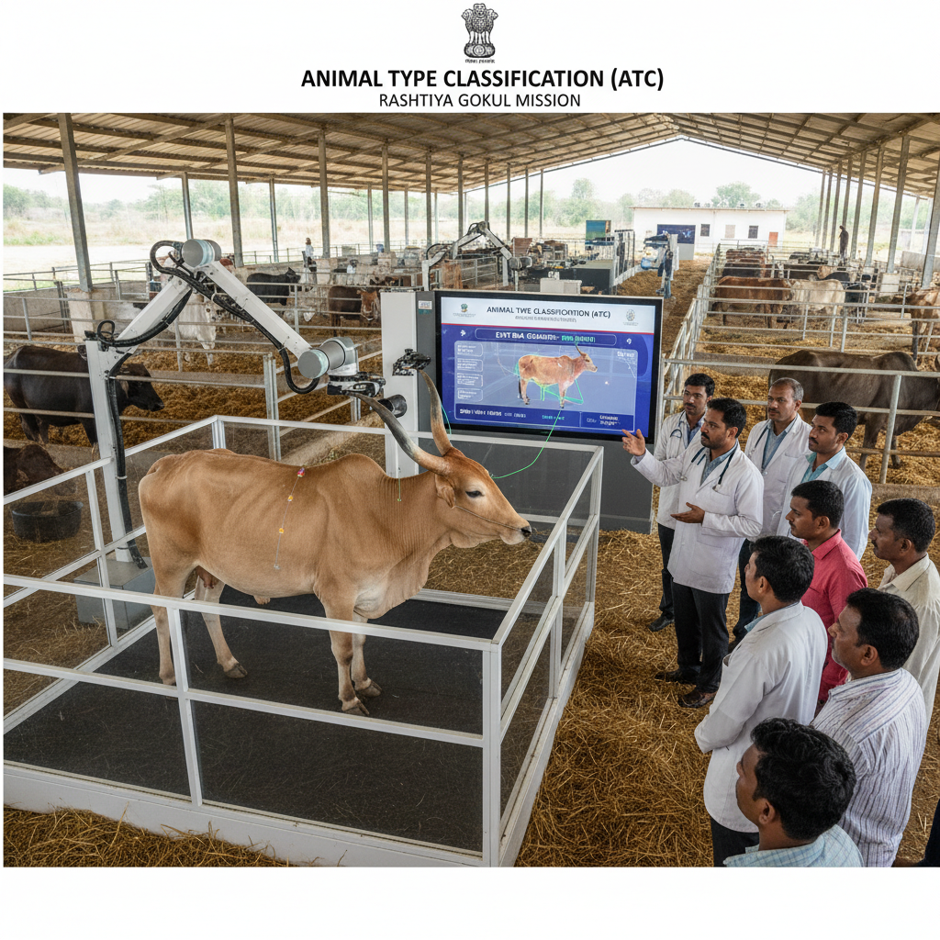
Introduction
This project supports the Rashtriya Gokul Mission (RGM), which aims to enhance the productivity of native cattle and buffalo breeds.
It focuses on Animal Type Classification (ATC) — evaluating animals’ physical traits to identify elite females for breeding programs like Progeny Testing and Pedigree Selection.
The project develops an AI-based system that automatically analyzes cattle and buffalo images for ATC, replacing manual, subjective evaluations with a data-driven, objective process.

Slide 4
Literature Survey
Sr. No | Paper and Author’s Name | Publication & year | Description | Challenges
1 | Computer-Vision-Based Sensing Technologies for Livestock Body Dimension Measurement: A Survey | MDPI Sensors, 2024 | Reviews methods where cows are photographed (2D or depth images) and body dimensions (length, height, width, etc.) are measured via image processing and deep learning. The survey covers works using RGB + depth, feature extraction, segmentation, etc. | Many methods rely on good image conditions; real-farm conditions (pose, occlusion, lighting, background) are less addressed. Depth cameras are helpful but expensive / less available in field. Also coverage of different traits (e.g. rump angle etc.) is limited.
2 | A first meta-analysis study on body weight prediction method for beef cattle based on digital image processing | Journal of Advanced Veterinary and Animal Research, 2023 | Meta-analysis of many studies: correlates body traits measured from images (wither height, hip height, chest depth, body length, top-view etc.) with actual body weight. The result gives insight into which traits correlate better in which breeds / sexes. | Meta-analysis uses varied datasets; measurement and trait definitions not uniform; many studies do not include all traits; field-level variability (breed, sex, environment) reduces generalizability.
3 | Automatic Cattle Identification using YOLOv5 and Mosaic Augmentation: A Comparative Analysis | arXiv, 2022 | Uses object-detection (YOLOv5) with augmentation for cattle muzzle identification / detection; focuses more on identifying individual cattle (for tags / identity) rather than full body structure. | Designed for muzzle / tag detection; does not extract full body structural parameters like chest width, rump angle, etc. Also might require clear views & quality images.
Notes:
4

Slide 5
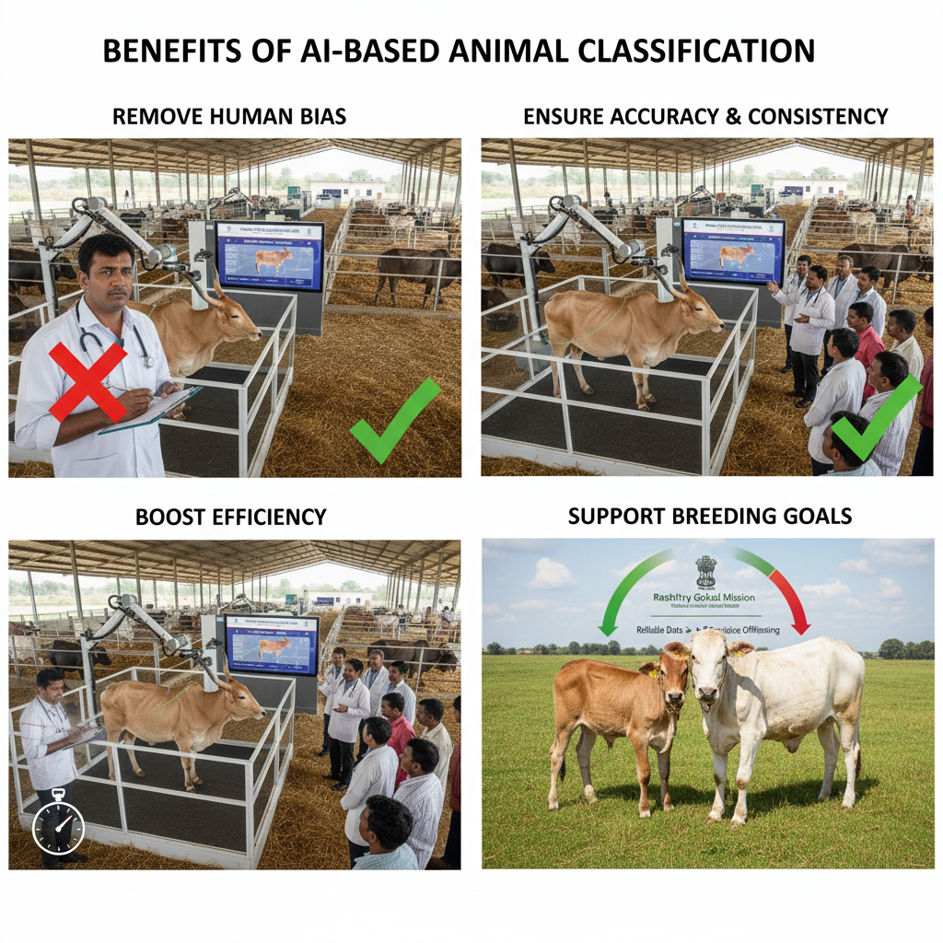
Motivation
Remove Human Bias: Replace manual, error-prone scoring with automated, objective analysis.
Ensure Accuracy & Consistency: AI ensures uniform, repeatable evaluations for every animal.
Boost Efficiency: Automation saves time and effort, enabling faster field assessments.

Slide 6

Problem Statement
The core challenge is that the manual process of Animal Type Classification (ATC) for cattle and buffaloes is subjective and prone to inconsistencies.
This inaccuracy compromises the data quality for crucial national breeding programs under the Rashtriya Gokul Mission. This creates a critical need for an AI-driven, automated system that can analyze animal images, extract key physical parameters, and generate objective classification scores with minimal human intervention.

Slide 7
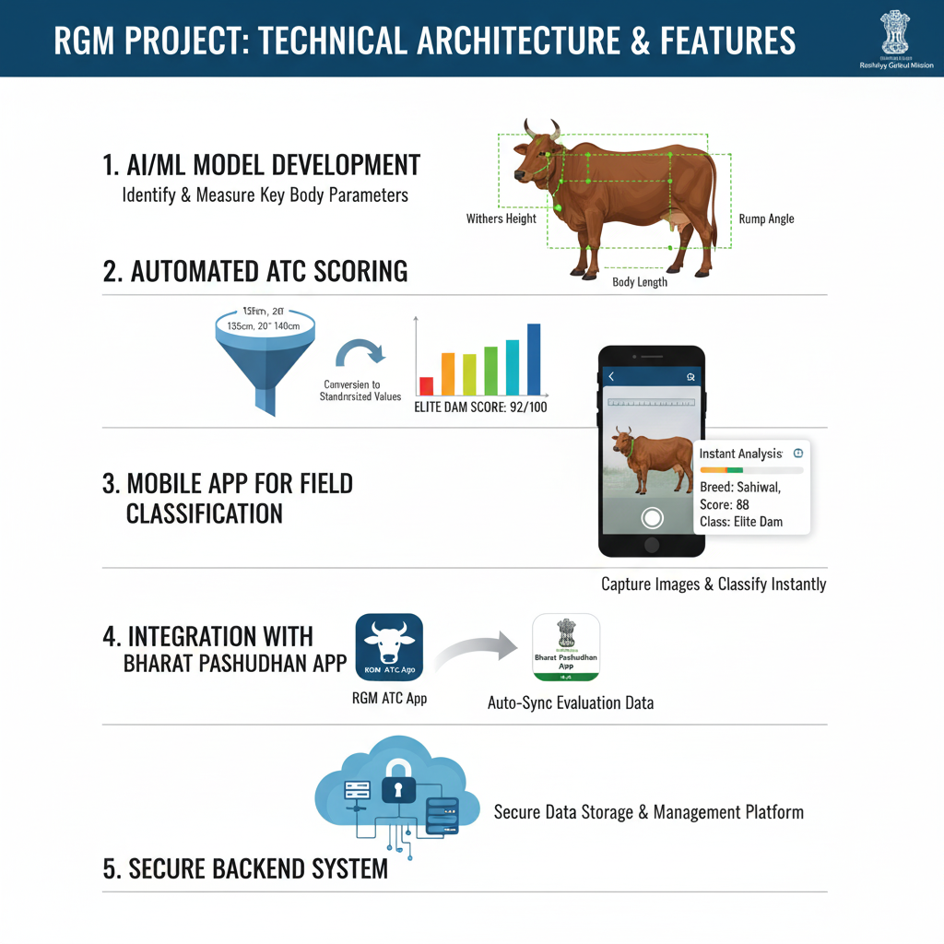
Objectives
Develop an AI/ML model to identify and measure key animal body parameters (withers height, rump angle, body length).
Automate ATC scoring by converting measurements into standardized values.
Create a mobile app for instant image capture and classification in the field.
Build a backend system for secure data storage and management.

Slide 8
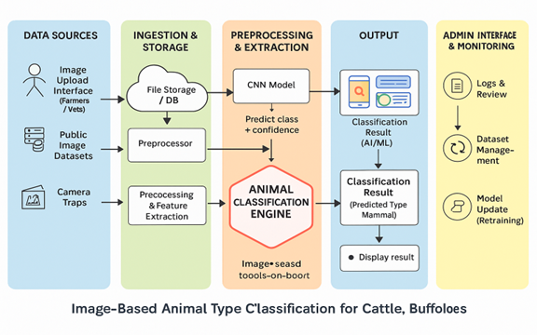
System Architecture
This architecture processes animal images from multiple data sources, including farmers, vets, public datasets, and camera traps.
The ingestion module stores the images and performs initial preprocessing before sending them to the classification engine.
A CNN-based model then predicts the animal type with confidence scores. The results are displayed to users, while an admin panel supports logs, dataset management, and model retraining.

Slide 9
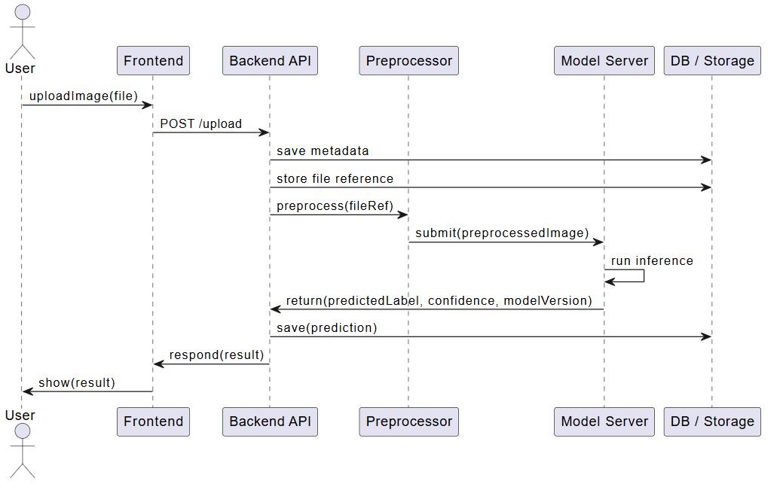
System workflow
Users upload an image, which is preprocessed and enhanced for analysis.
A CNN model analyzes the image and identifies the animal type.
The system predicts the class with a confidence score.
Results are stored in the database and displayed to users via the dashboard or API.

Slide 10
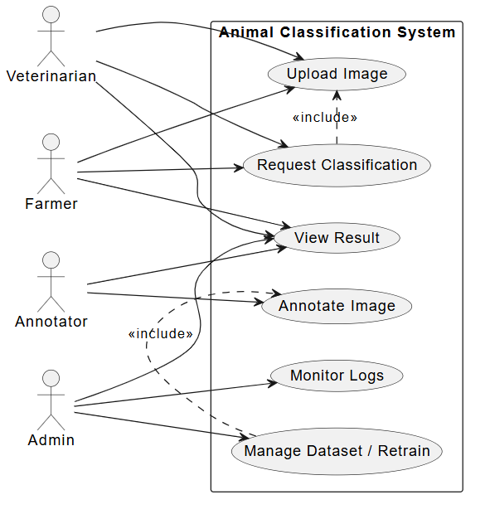
Use Case Diagram
The diagram shows a Use Case Model where different users—Veterinarians, Farmers, Annotators, and Admins—interact with the Animal Classification System.
Core actions include uploading images, requesting classification, viewing results, and for advanced users, annotating images, monitoring logs, and managing the dataset or retraining the model.

Slide 11
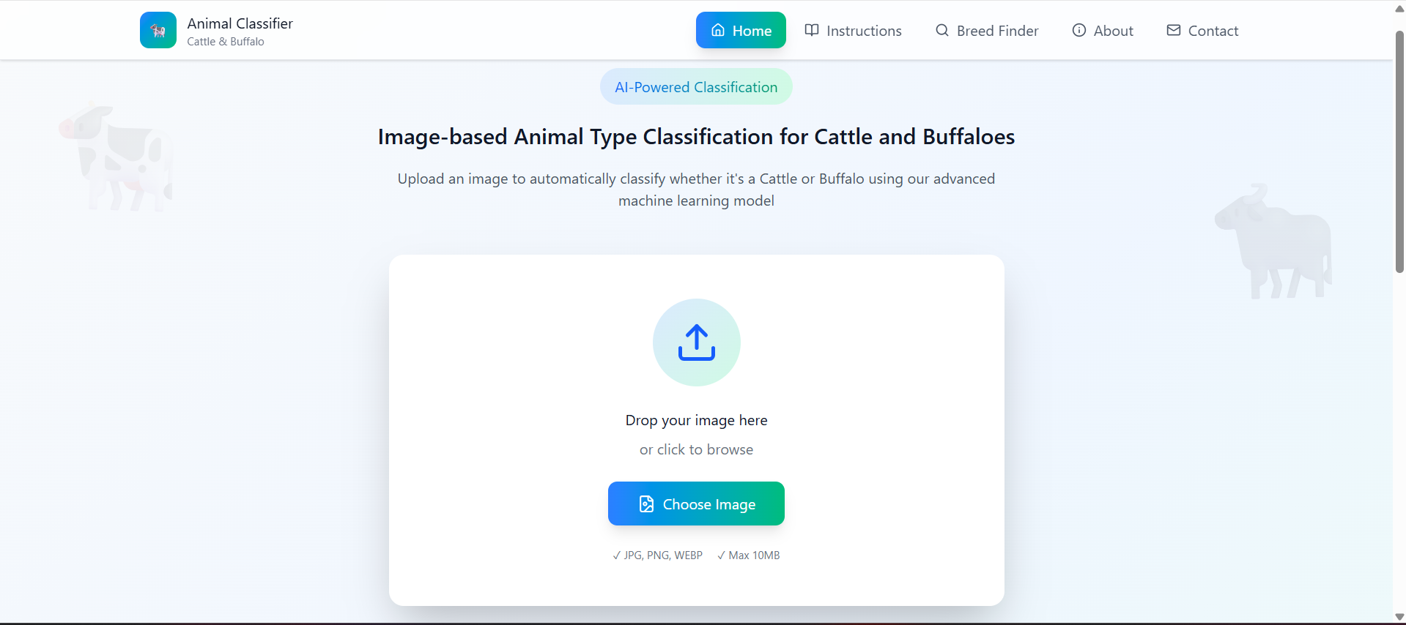
System Design Demo

Slide 12
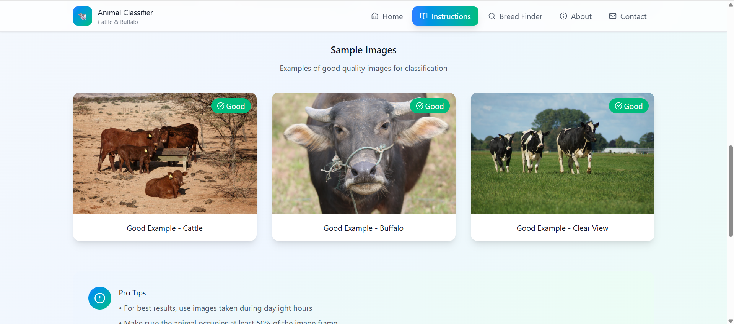
System Design Demo

Slide 13
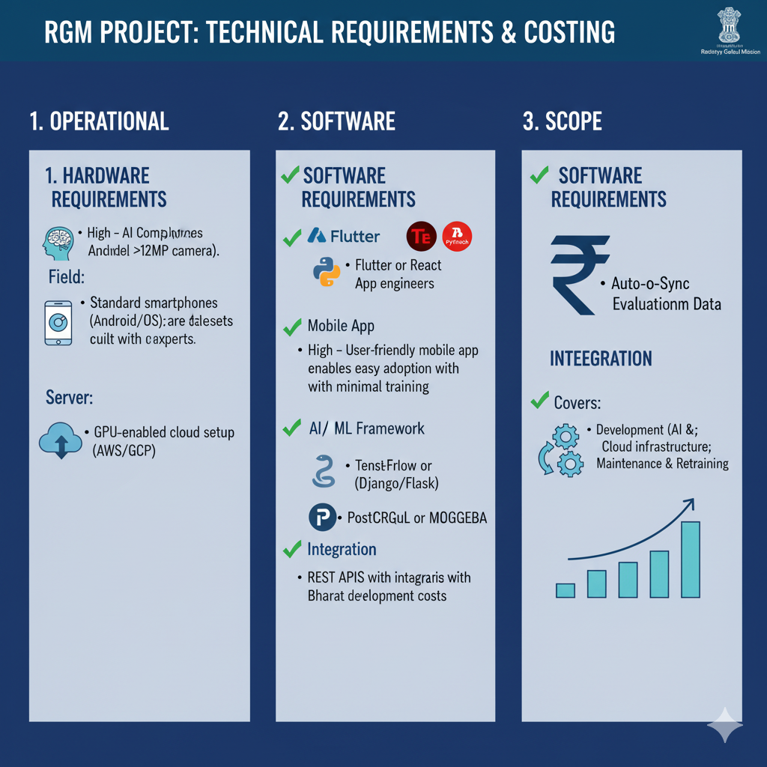
Requirement Analysis
Hardware Requirements:
  Field: Standard smartphones (Android/iOS) with a good quality camera (>12MP).
Software Requirements:
  Mobile App: Built using Flutter or React Native.
  Backend: Python (Django/Flask) for server-side logic.
  AI/ML Framework: TensorFlow or PyTorch for model development.

Slide 14
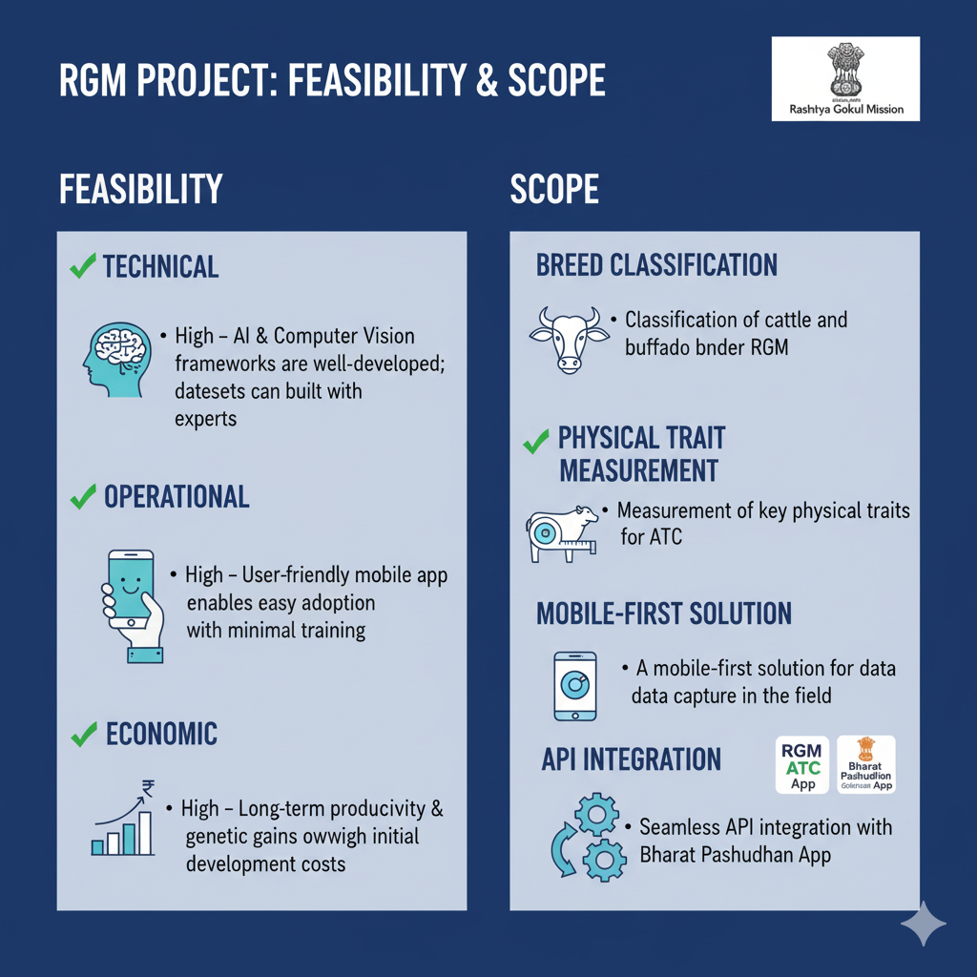
Feasibility and Scope
Feasibility
  AI and computer vision frameworks are well-developed; datasets can be built with experts.
  A user-friendly mobile app enables easy adoption with minimal training.
Scope
  Classification of cattle and buffalo breeds under RGM.
  Seamless API integration.

Slide 15
Conclusion
This AI-driven ATC system marks a significant advancement for India’s dairy sector.
By delivering reliable, data-driven evaluations, it supports the Rashtriya Gokul Mission’s goals of improving genetics, increasing milk yield, and enhancing farmer income.
The project stands as a scalable, tech-enabled solution to a vital agricultural challenge.

Slide 16

References
Hossain, M. E., et al. A systematic review of machine learning techniques for cattle identification using Machine Learning (ML) and Deep Learning (DL). 2022.
Mon, S. L., et al. AI-enhanced real-time cattle identification system through camera-based RGB images. 2024.
Li, D., Li, B., Qi, L., Wang, Y., Yang, M., Han, M., et al. “Cattle identification based on multiple feature decision-layer fusion.” Scientific Reports, 2024.
Pan, Y., Jin, H., Gao, J., Rauf, H. T. “Identification of Buffalo Breeds Using Self-Activated-Based Improved Convolutional Neural Networks.” Agriculture, 2022.
Ermetin, O. & Örnek, H. K. “Deep-learning-based buffalo identification through muzzle pattern images.” Archives of Animal Breeding, 2025.
“Improving artificial breeding of cattle and buffalo in Asia.” IAEA Publication TE-1480. Focuses on type classification, breed standards, and genetic improvement.

Slide 17
Thank You!

